Slide 1
Data Link Layer
MODULE 2

Slide 2
Data Link Layer Design Issues
Services Provided to the Network Layer
Framing
Error Control
Flow Control

Slide 3
Functions of the Data Link Layer
Provide service interface to the network layer
Dealing with transmission errors
Regulating data flow
  Slow receivers not swamped by fast senders

Slide 4
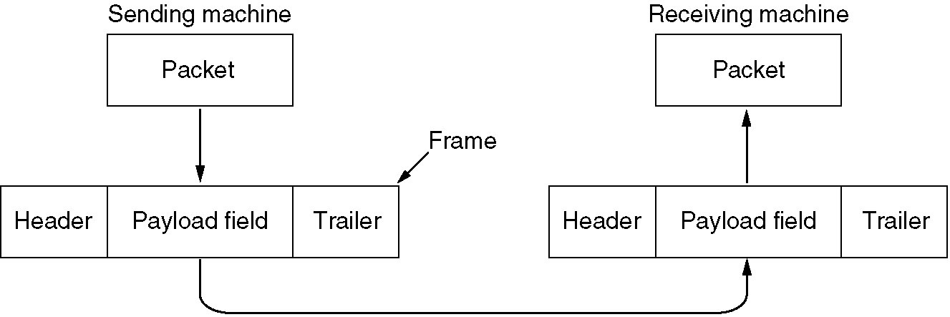
Functions of the Data Link Layer (2)
Relationship between packets and frames.

Slide 5
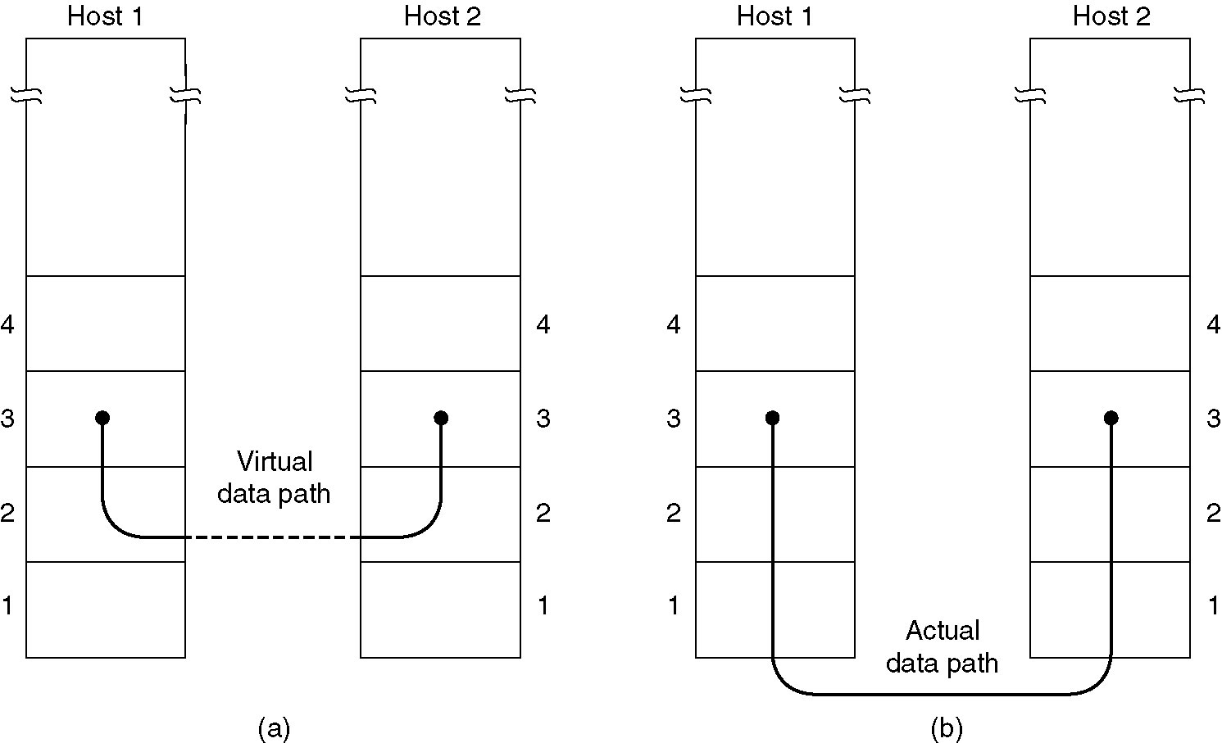
Services Provided to Network Layer
(a) Virtual communication.
(b) Actual communication.

Slide 6
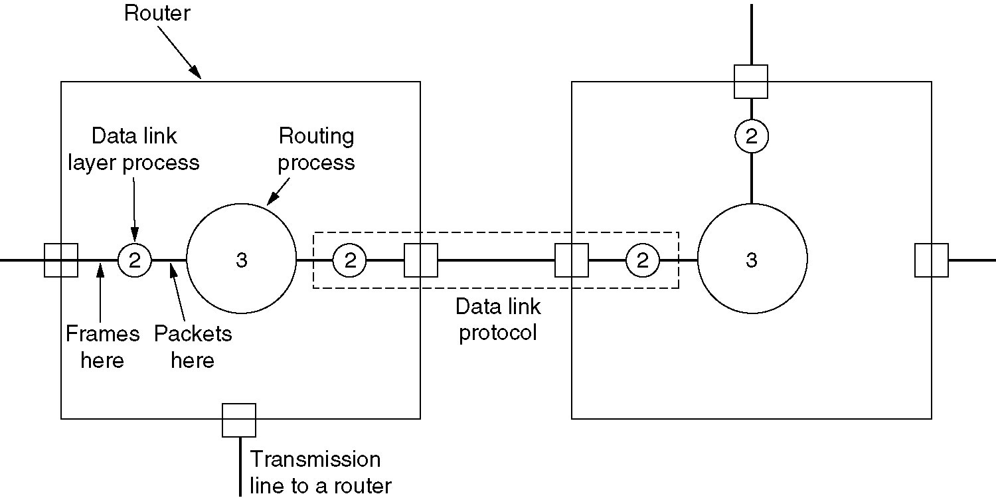
Placement of DLL protocol
Placement of the data link protocol.

Slide 7
Types of services provided to the Network Layer
Unacknowledged Connectionless service
Acknowledged Connectionless service
Acknowledged Connection-Oriented service

Slide 8
Unacknowledged Connectionless service
Losses are taken care of at higher layers
Used on reliable medium like coax cables or optical fiber, where the error rate is low.
Appropriate for voice, where delay is worse than bad data.

Slide 9
Acknowledged Connectionless service
Useful on unreliable medium like wireless.
Acknowledgements add delays.
Adding ack in the DLL rather than in the NL is just an optimization and not a requirement. Leaving it for the NL is inefficient as a large message (packet) has to be resent in that case in contrast to small frames here.
On reliable channels, like fiber, the overhead associated with the ack is not justified.

Slide 10
Acknowledged Connection-oriented service
Most reliable,
Guaranteed service –
  Each frame sent is indeed received
  Each frame is received exactly once
  Frames are received in order
Special care has to be taken to ensure this in connectionless services

Slide 11
Framing
Character Count
A field in the header to specify the number of character in the frame.
Flag bytes with byte stuffing
Flag bytes with bit stuffing

Slide 12
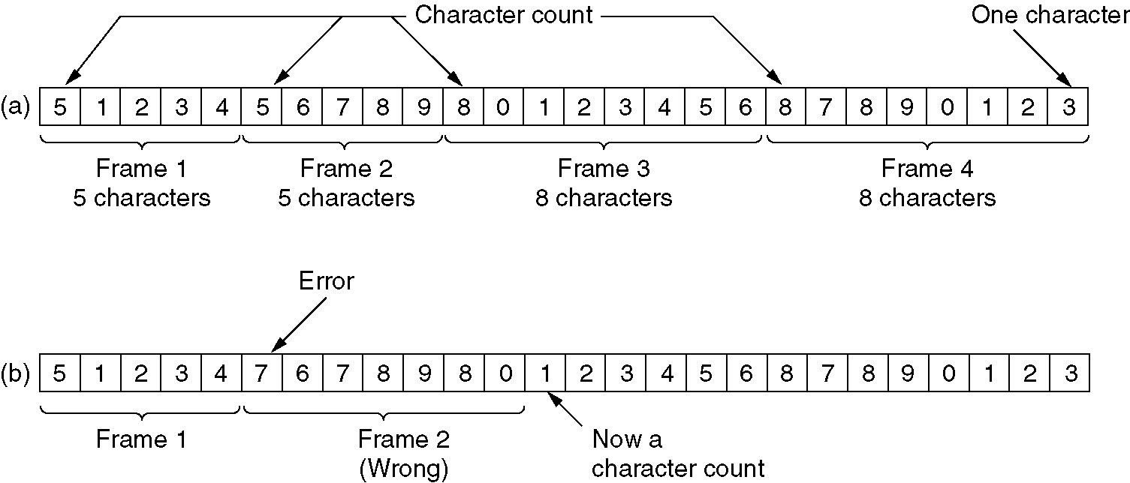
Framing with Character Count
A character stream. (a) Without errors. (b) With one error.

Slide 13
Problem with Framing with CC
What if the count is garbled
Even if with checksum, the receiver knows that the frame is bad there is no way to tell where the next frame starts.
Asking for retransmission doesn’t help either because the start of the retransmitted frame is not known.
No longer used

Slide 14
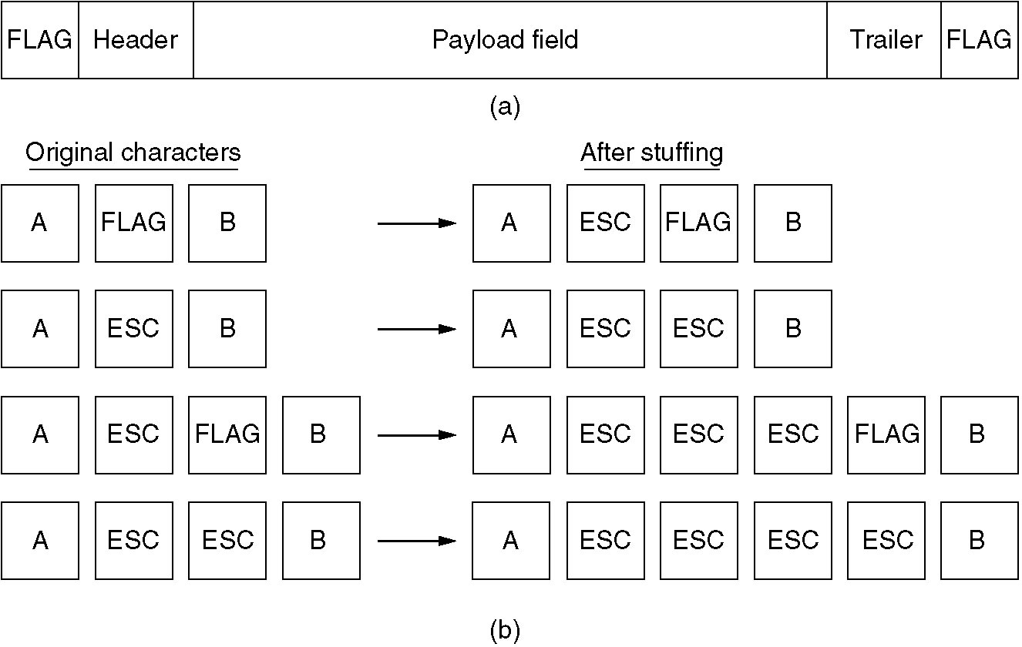
Framing with byte stuffing
(a)A frame delimited by flag bytes (b) examples of byte stuffing

Slide 15
Byte stuffing
Each frame start and end with special bytes.
called Flag byte
If receiver ever loses synchronization ,it can just search for the flag byte to find the end of the current frame.
Two consecutive flag bytes indicate the end of one frame and start of the next one.
Sender’s DLL insert a special escape byte (ESC) just before each accidental flag byte in the data this is known as byte stuffing or character stuffing .

Slide 16
Framing with byte stuffing
Problem : fixed character size : assumes character size to be 16 bits(UNICODE) : can’t handle heterogeneous environment.

Slide 17
Starting and ending flag with bit stuffing
Each frame begin with a bit pattern 01111110
Whenever the sender ‘s dll encounters five consecutive ones ,it automatically stuffs a ‘0 ’ bit into the bitstream

Slide 18
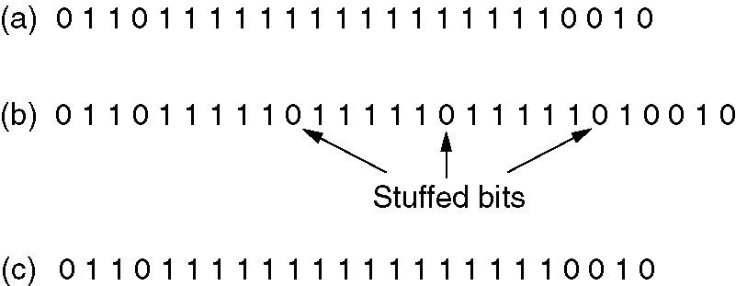
Framing with bit stuffing
Bit stuffing
(a) The original data.
(b) The data as they appear on the line.
(c) The data as they are stored in receiver’s memory after destuffing.

Slide 19
Error Control
Positive and Negative feedback
Timers : what happens when a frame completely vanishes : receiver neither sends a +ack nor –ack … then timer comes to help.
  It may result in a frame being sent more than once and received more than once :
  solution : assign sequence numbers to frames

Slide 20
Flow control
Feedback based flow control
  Receiver sends back information to the sender giving it permission to send more data.
Rate based flow control
  The protocol has a built in mechanism that limits the rate at which senders may transmit data,without using feedback from the receiver.

Slide 21
FLOW AND ERROR CONTROL
The most important responsibilities of the data link layer are flow control and error control . Collectively, these functions are known as data link control .
DLL can combine framing, flow control, and error control to achieve the delivery of data from one node to another.
Using protocols

Slide 22
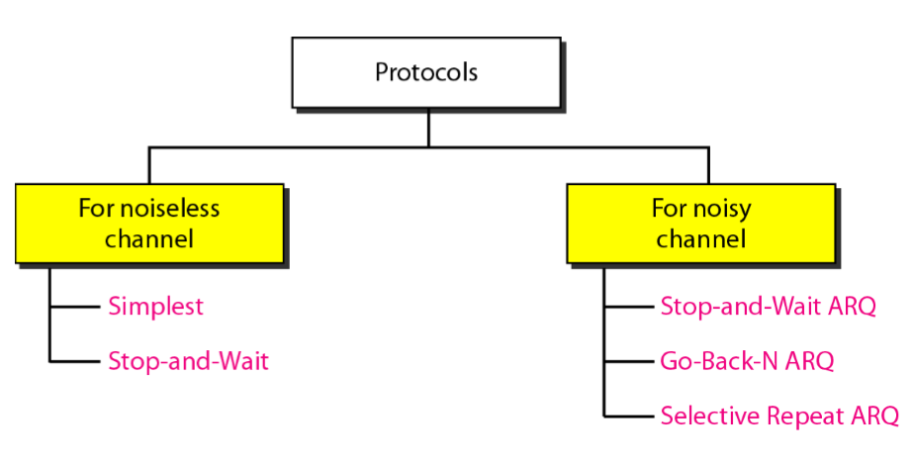

Slide 23
NOISELESS CHANNELS
Let us first assume we have an ideal channel in which no frames are lost, duplicated, or corrupted .
Simplest Protocol – has no flow or error control

Slide 24
Simplest Protocol
one that has no flow or error control.
It is a unidirectional protocol in which data frames are traveling in only one direction - from the sender to receiver.
The receiver can never be fill out with incoming frames.

Slide 25
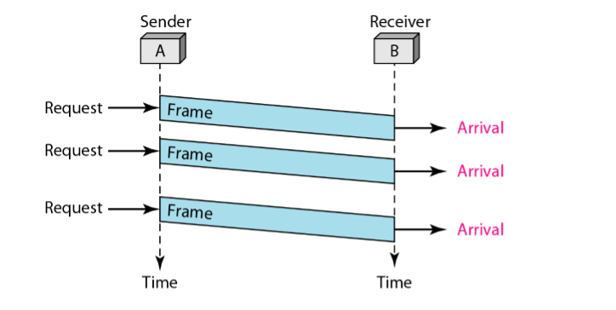

Slide 26
Stop-and-Wait Protocol
If data frames arrive at the receiver site faster than they can be processed, the frames must be stored until their use. Normally, the receiver does not have enough storage space, especially if it is receiving data from many sources.
We need to tell the sender to slow down. There must be feedback from the receiver to the sender.

Slide 27
The sender sends one frame, stops until it receives agreement the receiver (okay to go ahead), and then sends the next frame.
still have unidirectional communication for data frames, but auxiliary ACK frames (simple tokens of acknowledgment) travel from the other direction.
We add flow control to our previous protocol.

Slide 28
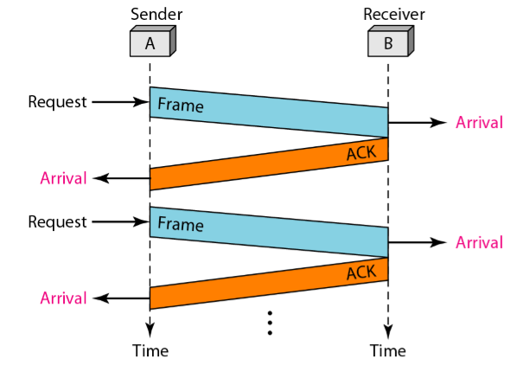

Slide 29
NOISY CHANNELS
Although the Stop - and - Wait Protocol gives us an idea of how to add flow control to its predecessor, noiseless channels are nonexistent.

Slide 30
Stop-and-Wait Automatic Repeat Request(ARQ)
Error correction in Stop-and-Wait ARQ is done by keeping a copy of the sent frame and retransmitting of the frame when the timer expires.
use sequence numbers to number the frames. The sequence numbers are based on modulo-2 arithmetic.
the acknowledgment number always announces the sequence number of the next frame expected.

Slide 31
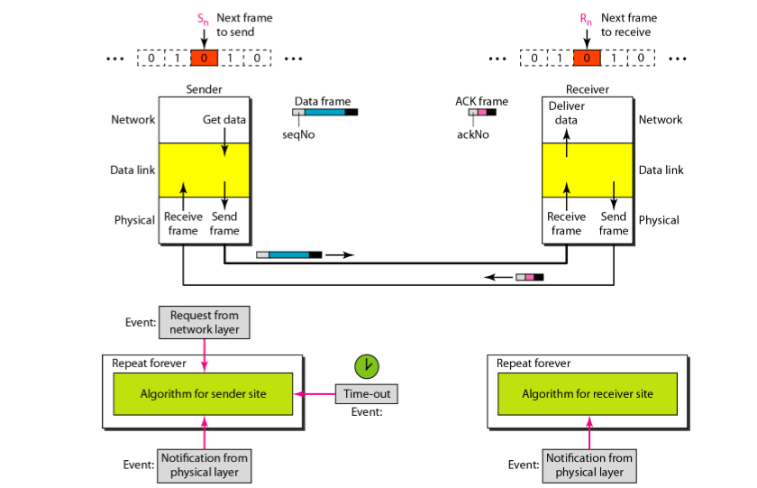

Slide 32
example of Stop - and - Wait ARQ .
Frame 0 is sent and acknowledged .
Frame 1 is lost and resent after the time - out .
The resent frame 1 is acknowledged and the timer stops .
Frame 0 (second ) is sent and acknowledged, but the acknowledgment is lost .
The sender has no idea if the frame or the acknowledgment is lost, so after the time - out, it resends frame 0 , which is acknowledged.

Slide 33
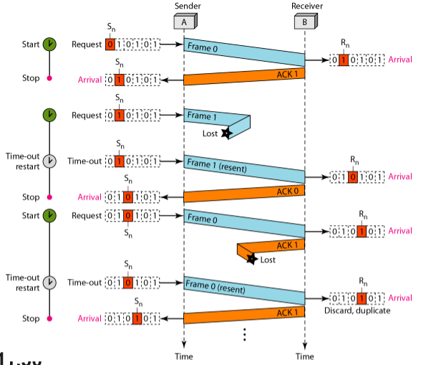

Slide 34
Efficiency
This protocol is inefficient if the channel has large bandwidth and long round trip time.
Round trip time: is the time required for a signal pulse or packet to travel from a specific source to a specific destination and get back the acknowledgement.

Slide 35
Pipelining
In networking and in other areas, a task is often begun before the previous task has ended.This is known as pipelining.
There is no pipelining in Stop-and-Wait ARQ because we need to wait for a frame to reach the destination and be acknowledged before the next frame can be sent.
Pipelining improves the efficiency of the transmission if the number of bits in transition is large with respect to the bandwidth-delay .

Slide 36
Go-Back-N Automatic Repeat Request
To improve the efficiency of transmission (filling the pipe), multiple frames must be in transition while waiting for acknowledgment.
we need to let more than one frame be outstanding to keep the channel busy while the sender is waiting for acknowledgment.
We keep a copy of these frames until the acknowledgments arrive, Thus need sequence number for frames.

Slide 37
For example, if m is 4 , the only sequence numbers are 0 through 15 inclusive. However, we can repeat the sequence.
In the Go-Back-N Protocol, the sequence numbers are modulo 2 ^m , where m is the size of the sequence number field in bits.

Slide 38
Sliding window
Is an abstract concept that defines the range of sequence number that is the concern of the sender and receiver.
The range at which is the concern of sender is send sliding window.
The range at which is the concern of the receiver is called receive sliding window.

Slide 39
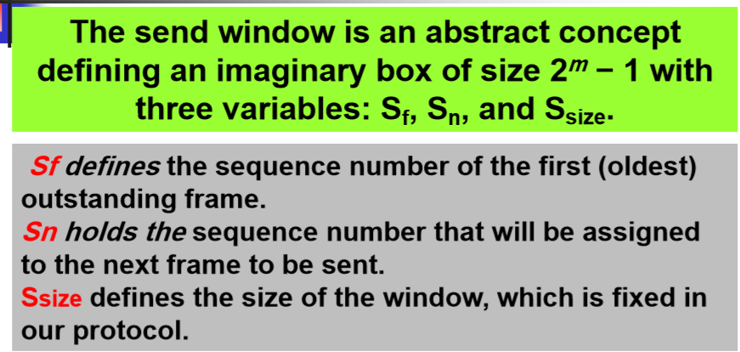

Slide 40
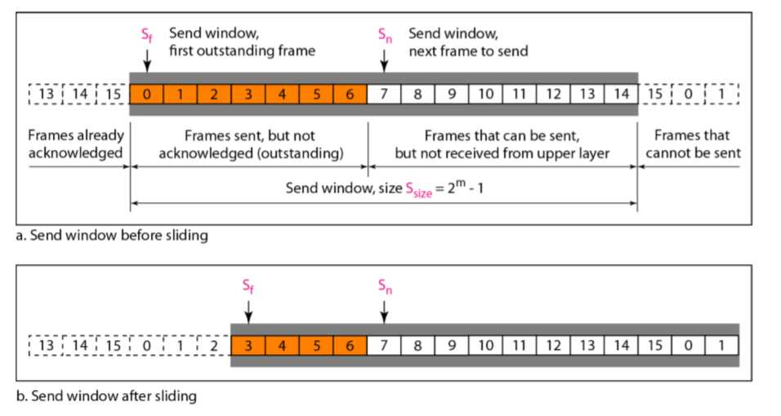

Slide 41
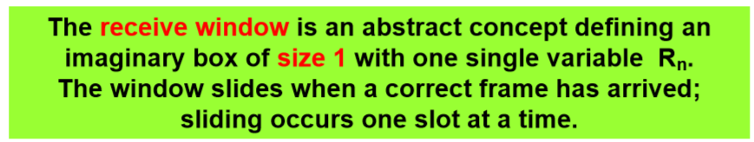
Send window can slide one or more slots when a valid acknowledgment arrives.
Receive window make sure that correct data frames are received and that the correct acknowledgment are sent .

Slide 42
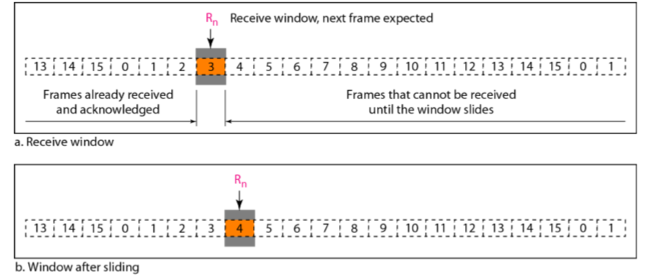

Slide 43
Timers : although there can be timer for each frame that is sent, this protocol uses only one,
Timer for the first outstanding frame always expires first ; we send all outstanding frames when this timer expires.
Acknowledgment :receiver send a postive acknowlegement if a frame has arrived safe and sound in order.
If a frame is damaged or received out of order , receiver will discard all subsequent frames until it receives the one it is expecting.

Slide 44
Expires the timer at the sender side,the sender resend all frames ,beginning with the one with the expired timer.
The receiver does not have to acknowledge each frame received .
It can send one cumulative acknowledgment for several frames.

Slide 45
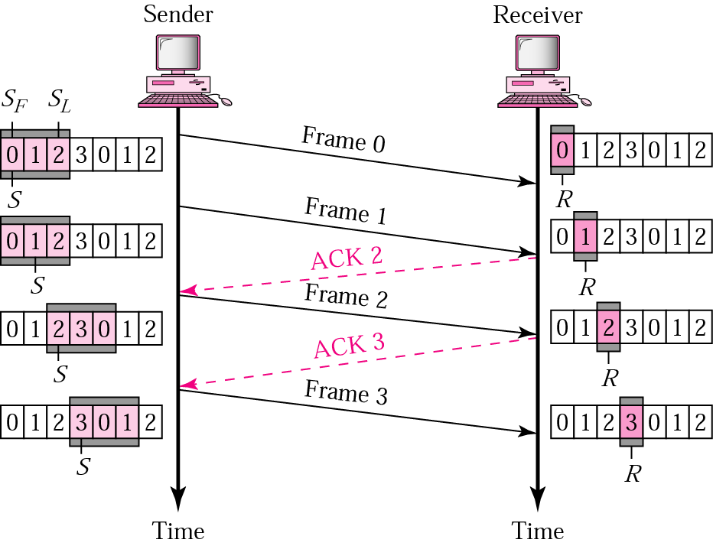
Go-Back-N ARQ, normal operation
The sender keeps track of the outstanding frames and updates the variables and windows as the ACKs arrive.

Slide 46
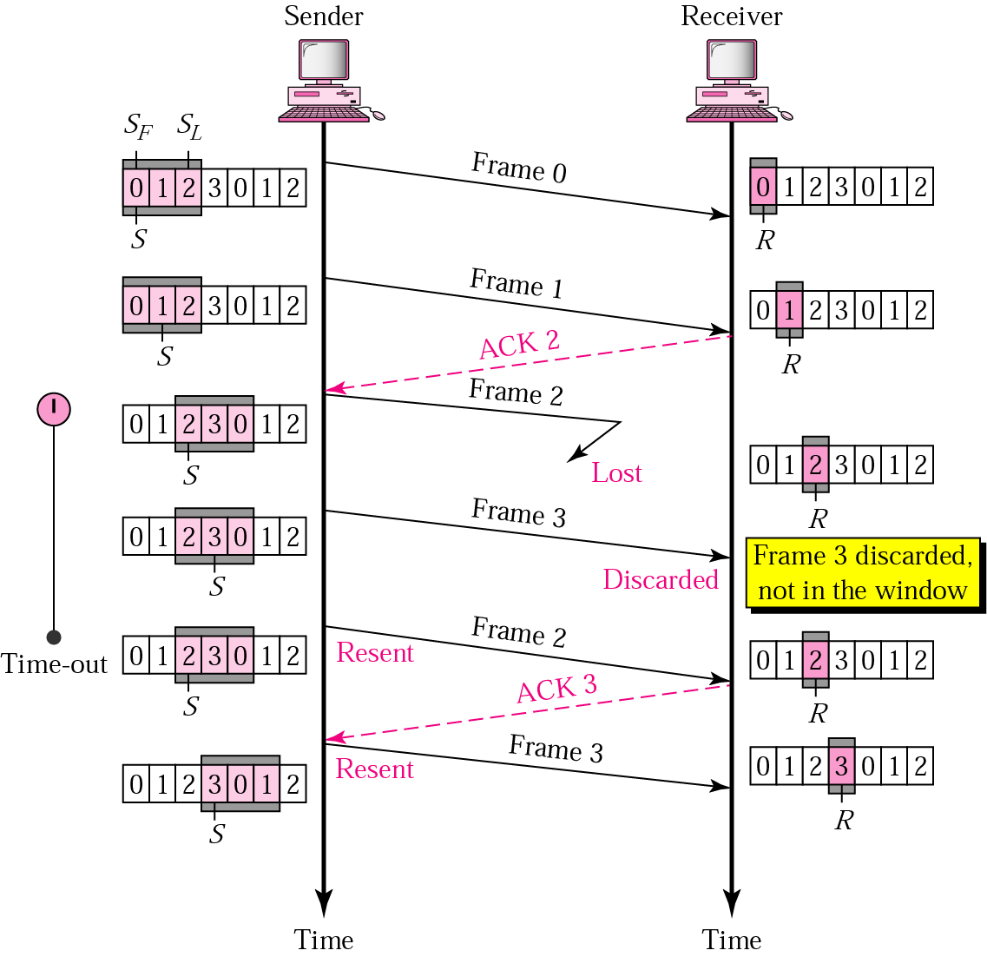
Go-Back-N ARQ, lost frame

Slide 47
Frame 2 is lost
When the receiver receives frame 3, it discards frame 3 as it is expecting frame 2 (according to window).
After the timer for frame 2 expires at the sender site, the sender sends frame 2 and 3. (go back to 2)

Slide 48
Go-Back-N ARQ, damaged/lost/delayed ACK
If an ACK is damaged/lost, we can have two situations:
If the next ACK arrives before the expiration of any timer, there is no need for retransmission of frames because ACKs are cumulative in this protocol.
If ACK1, ACK2, and ACk3 are lost, ACK4 covers them if it arrives before the timer expires.
If ACK4 arrives after time-out, the last frame and all the frames after that are resent.
Receiver never resends an ACK.
A delayed ACK also triggers the resending of frames

Slide 49
Go-Back-N ARQ, sender window size
Size of the sender window must be less than 2 ^{m}. Size of the receiver is always 1. If m = 2, window size = 2 ^{m} – 1 = 3.
Figure compares a window size of 3 and 4.

Slide 50
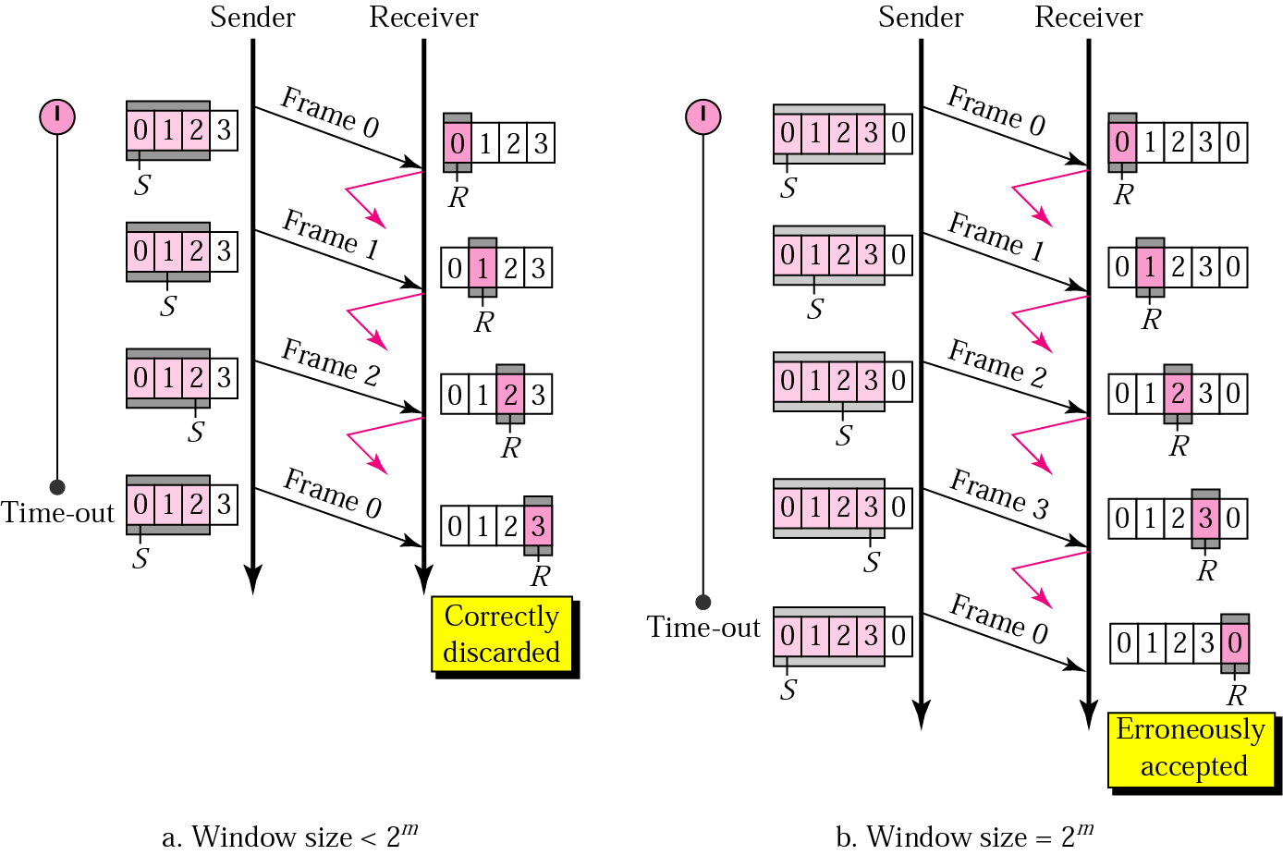

Accepts as the 1st frame in the next cycle-an error

Slide 51
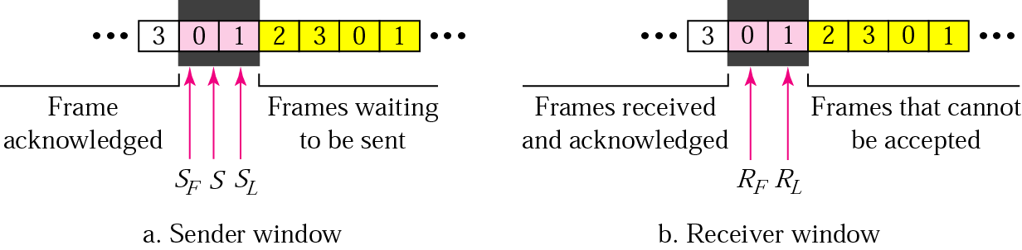
Selective Repeat ARQ, sender and receiver windows
Go-Back-N ARQ simplifies the process at the receiver site. Receiver only keeps track of only one variable, and there is no need to buffer out-of-order frames, they are simply discarded.
However, Go-Back-N ARQ protocol is inefficient for noisy link. It bandwidth inefficient and slows down the transmission.
In Selective Repeat ARQ, only the damaged frame is resent. More bandwidth efficient but more complex processing at receiver.
It defines a negative ACK (NAK) to report the sequence number of a damaged frame before the timer expires.

Slide 52
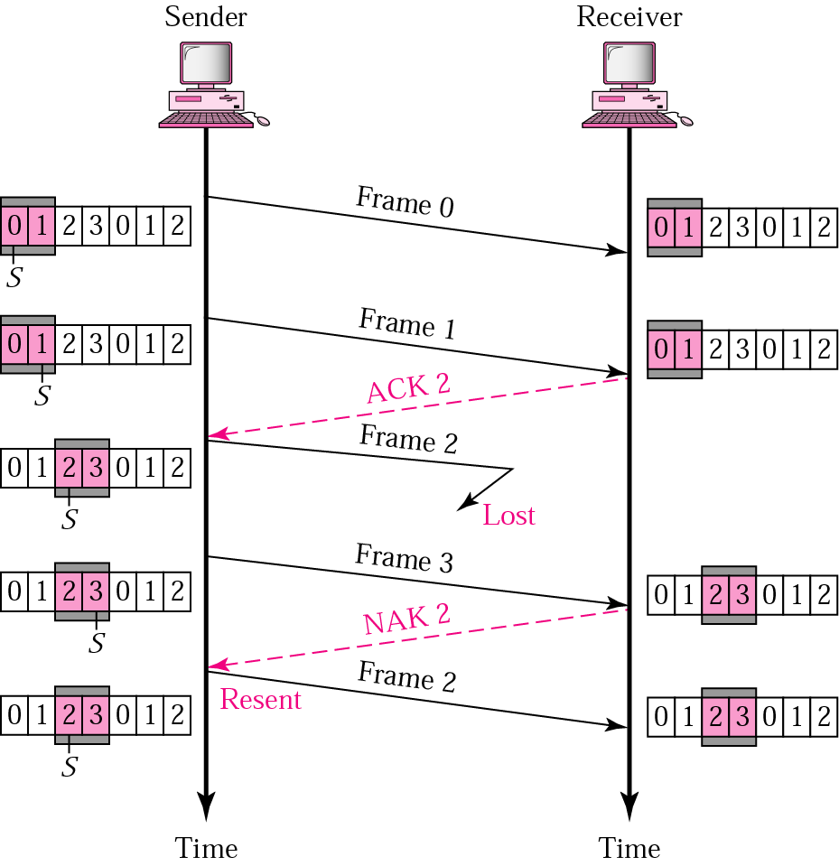
Selective Repeat ARQ, lost frame
Frames 0 and 1 are accepted when received because they are in the range specified by the receiver window. Same for frame 3.
Receiver sends a NAK2 to show that frame 2 has not been received and then sender resends only frame 2 and it is accepted as it is in the range of the window.

Slide 53
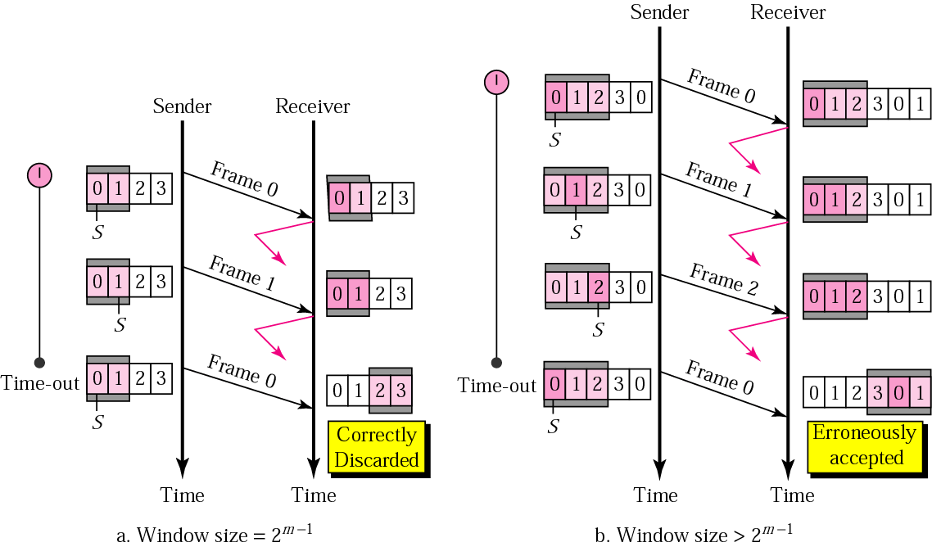
Selective Repeat ARQ, sender window size
Size of the sender and receiver windows must be at most one-half of 2 ^{m}. If m = 2, window size should be 2 ^{m} /2 = 2. Fig compares a window size of 2 with a window size of 3. Window size is 3 and all ACKs are lost, sender sends duplicate of frame 0, window of the receiver expect to receive frame 0 (part of the window), so accepts frame 0, as the 1st frame of the next cycle – an error.

Slide 54
  Piggybacking
Protocols we discussed are all unidirectional.
Data frames in one direction and control information such as ACK and NAK frames can travel in the other direction.
In real data frames are normally flowing in both direction.
When a frame is carrying data from A to B;it can also carry control information about arrived (or lost )frames from B,this technique is called piggybacking

